Slide 1
Global leader in performance marketing

Slide 2
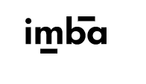

Slide 3
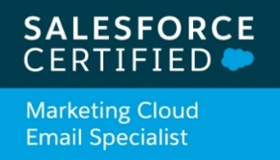
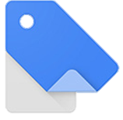
paid search experts +
organic search experts +
social media experts +
data & analytics experts +
programmatic experts+
digital account managers +
engineers +
research
30 Display
Certifications
30 Mobile
Certifications
30 Search
Certifications
11 Bing Certifications
24 FB Blueprint Certifications
30 Analytics Certifications
30 Video
Certifications
9 DV360
Certifications
30 Shopping
Certifications
30 diverse digital
marketing experts
1 GMP
Certified
Trainer

Slide 4
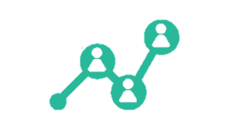
DIGITAL MEDIA HANDLED
YouTube
Facebook
LinkedIn
Instagram
Gmail Sponsored Ads
Paid Search
Affiliate
Yahoo/Oath
Programmatic
Twitter

Slide 5
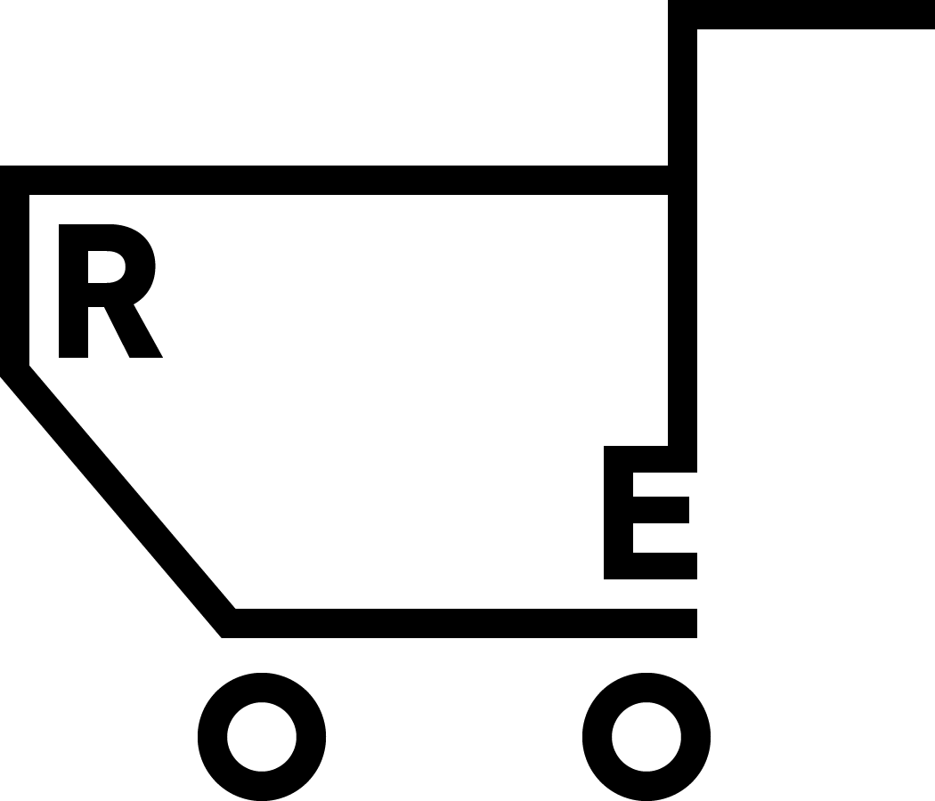
BEYOND DIGITAL MEDIA
BUSINESS MESSAGING
E-COMMERCE
SEO
DATA
Onsite / Offsite
Google Analytics Set Up
Omnichannel Messaging
CRO
YouTube SEO
Attribution Model Creation
E-Retail Management
Marketing Automations
Brand Reputation Management
Advanced Reporting
A/B Testing
Email Marketing Strategy

Slide 6
“Black Friday in a COVID Era” Trends.

Slide 7
Foot Traffic Becomes Web Traffic.

Slide 8
Foot Traffic Becomes Web Traffic
Consumers will tend to avoid crowded places.
Large shift from foot traffic to web traffic
Not just a choice, sometimes the only option

Slide 9
Mobile Rules the Game.

Slide 10
Mobile Rules the Game
Over 70% of online consumers are using mobile devices to shop.
Time spent on mobile phones has increased by 30% since the pandemic started.

Slide 11
Contactless Shopping Options.

Slide 12
Contactless Shopping Options
Growing Demand for Click & Collect Options
Delivery Service is the Last Impression of a Customer
Win-Win & Cost effective for both Retailers and Consumers

Slide 13
Consumers’ Preferences Change.

Slide 14
Consumers’ Preferences Change
Consumers become impatient. Product shortages make them look for other brands.
Consumers re-evaluate the brands they love based on the brand’s approach to COVID-19.

Slide 15
How to Plan for Success.

Slide 16
Start Early.

Slide 17
Take advantage of lower competition
presence
Use a year-long landing page for Black Friday
Start early, build anticipation
Collect messaging subscriptions

Slide 18
Take advantage of lower competition
presence
Use a year-long landing page for Black Friday
Start early, build anticipation
Collect messaging subscriptions

Slide 19
Take advantage of lower competition
presence
Use a year-long landing page for Black Friday
Start early, build anticipation
Collect messaging subscriptions

Slide 20
Take advantage of lower competition
presence
Use a year-long landing page for Black Friday
Start early, build anticipation
Collect messaging subscriptions

Slide 21
Focus on your USPs.

Slide 22
No questions asked return policy
Fast shipping
Safety measures
Contactless delivery

Slide 23
Create Smart Discounts.

Slide 24
Create Smart Discounts
Don’t heavily discount products that are not going to sell. Use smaller discounts on best selling products!
Combine best selling products as a gift set.

Slide 25
Invest in your Website.

Slide 26
Invest in your Website
Make sure to keep your website up and running.
Give mobile users what they want.
Prepare for traffic peaks!

Slide 27
Invest in your Website
Make sure to keep your website up and running.
Give mobile users what they want.
Mobile first, simplify forms, make checkout smooth

Slide 28
Dominate Performance Campaigns.

Slide 29
Review Last Year’s Performance
Have a cross-channel strategy
Own your brand
Keep an eye on the competition
Start early
What did you learn?
What can you do better?

Slide 30
Review Last Year’s Performance
Have a cross-channel strategy
Own your brand
Keep an eye on the competition
Start early
Gather significant data
Minimize the learning period

Slide 31
Review Last Year’s Performance
Have a cross-channel strategy
Own your brand
Keep an eye on the competition
Start early
Consistent tone of voice across channels
Strong coverage across channels

Slide 32
Review Last Year’s Performance
Have a cross-channel strategy
Own your brand
Keep an eye on the competition
Start early
Black Friday Google Search demand is driven by branded searches
Invest in Awareness
Don’t let resellers outrank you

Slide 33
Review Last Year’s Performance
Have a cross-channel strategy
Own your brand
Keep an eye on the competition
Start early
Take advantage of failed competitors’ strategies

Slide 34
Good luck!
Christos Keramidas, Client Partner, REPRISE
Christos.Keramidas@reprisedigital.com
https://www.linkedin.com/in/christos-keramidas/

