Slide 1
How to Overcome
the Challenges of E-Commerce Logistics
at Scale
Fotini Skapinaki
Commercial Manager@Logika

Slide 3


Slide 4
Turnover on Logistics - Spending
20%
Storage
Order Picking
Packing
Shipping
Returns
…and these customers have plenty of opportunity to search for alternative online stores selling the same products when they see high delivery costs, with over 800,000 online stores in Europe alone.
80% Logistics Spending | 20% Rest Expenses

Slide 5

Set up Logistics Process
Logistics
process in
various ways:
e-Fulfilment
Drop Shipping

Slide 6
Managing Logistics in E-Commerce is Critical
If your logistics
is not set up in
the best possible
way, chances are
that your
conversions will
suffer
Your only option
will be to make
sacrifices &
compromises,
resulting in sky-high
logistical costs
Proper Delivery
is synonymous
with business
success

Slide 7
E-Customer expectations
No 1 reason for European shoppers to abandon their carts = slow delivery.
Shipping experience has a considerable impact on your business since it affects customer loyalty. A survey reveals that 96% of shoppers would return to the same online shop after having had a positive delivery experience.
Customer Satisfaction
Profit
Balance

Slide 8
The impact of Covid19 for e-commerce logistics
One thing that remains constant in these uncertain times:
E-commerce industry grows
Lots of Delays
Customers are choosing online over in –store
Complexities in the entire supply chain infrastructure

Slide 9

Consumers don’t like to wait..
But the ecommerce logistics infrastructure needed to meet consumers’ demands
is not easy to achieve by yourself.

Slide 10
How to improve your e-supply chain
1. Make a tight stock control / Demand Planning
2. Find an Ecommerce Logistics Partner Early for greater scalability- Economies of Scale & Generate Extra Revenue
3.Focus on Your Core Competencies
4. Visibility of Costs Through Accurate Budget Control and Reporting
5. Set delivery deadline well – Free Shipping as a marketing tactic
6.Transparency into the supply chain
7. Efficient Real-time Tracking

Slide 13

End Customer experience
Placing your
Order
Picking a time
window
Link via SMS with updates
On the every step
Live ETA and
Trucking
Rate the
experience

Slide 14
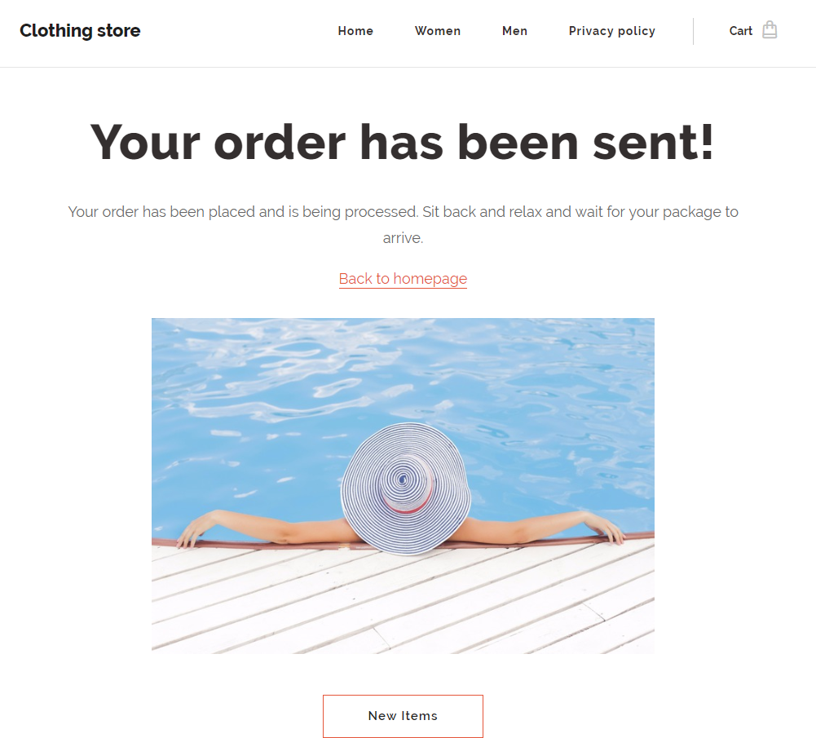
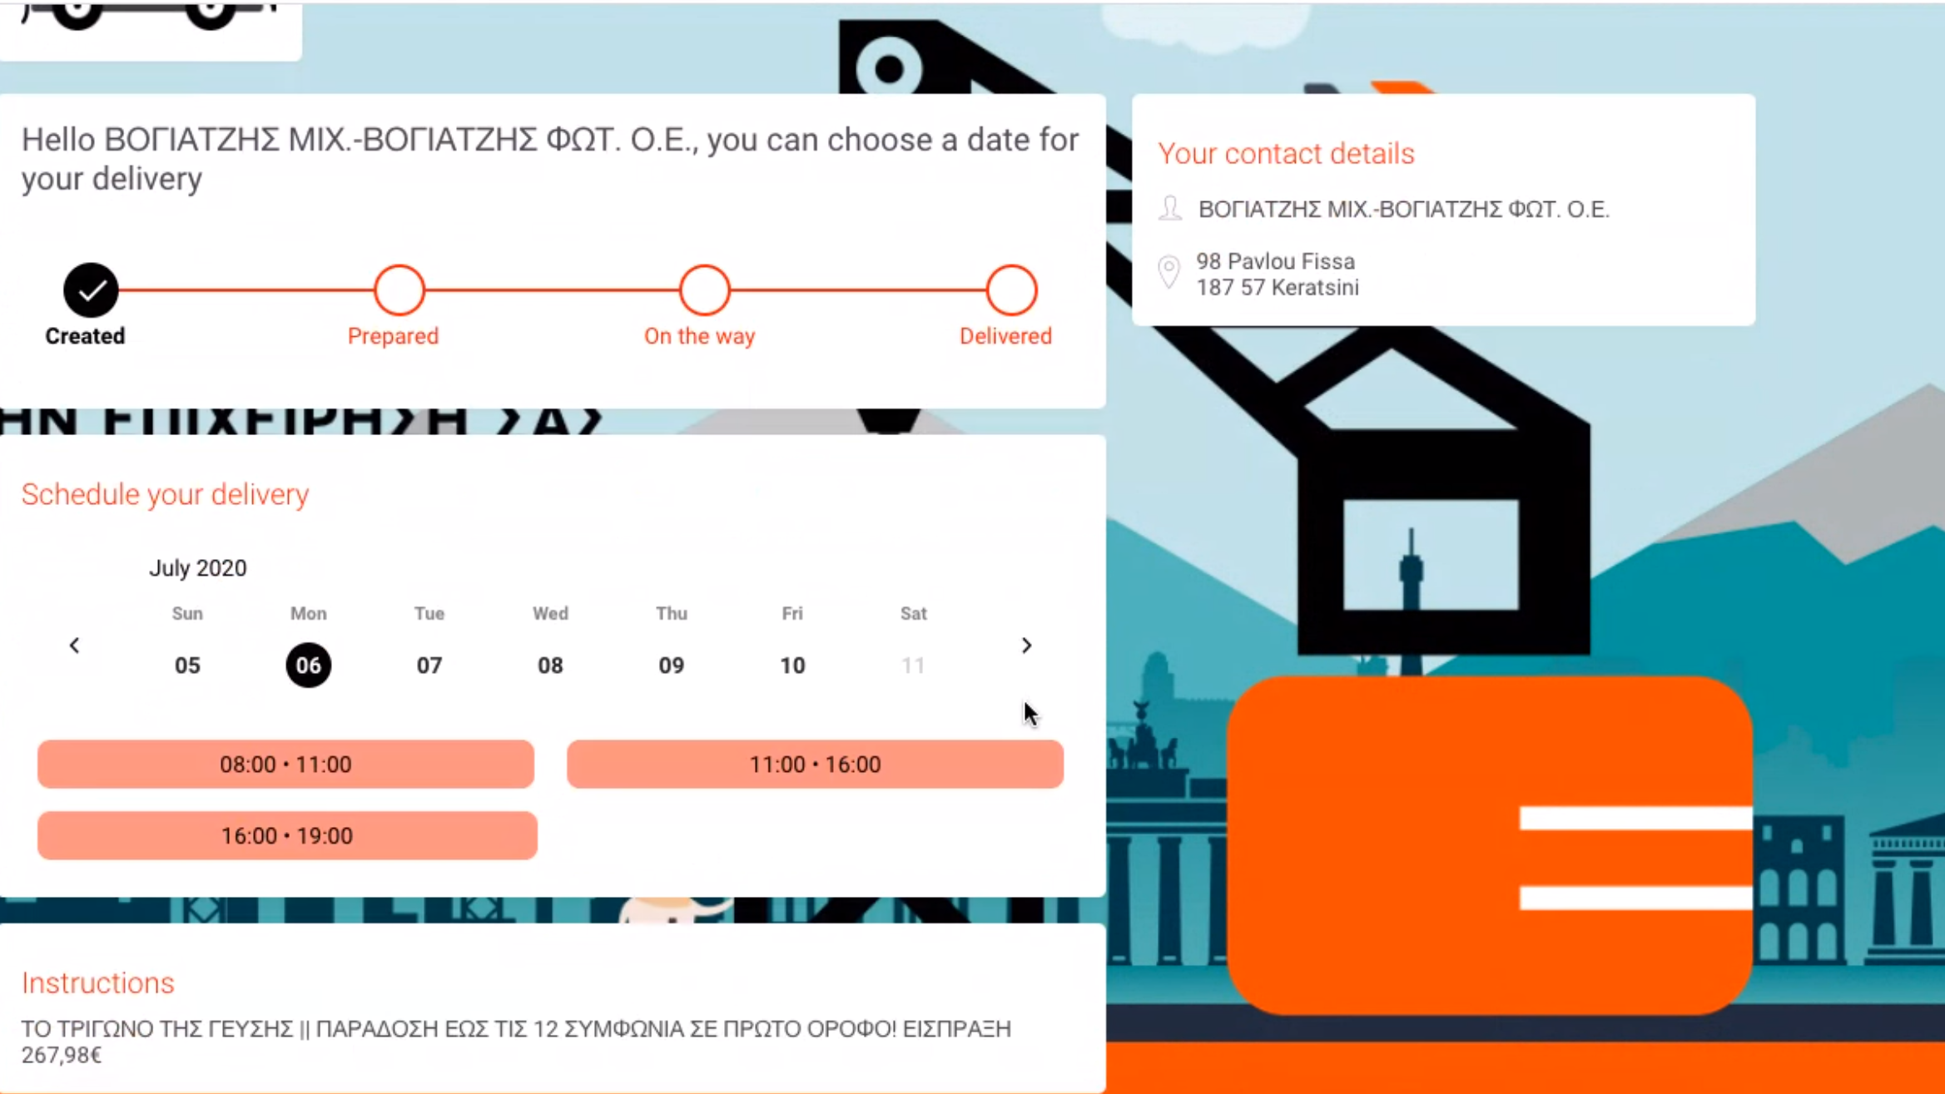
Step 1&2:Placing order and picking a time window

Slide 15
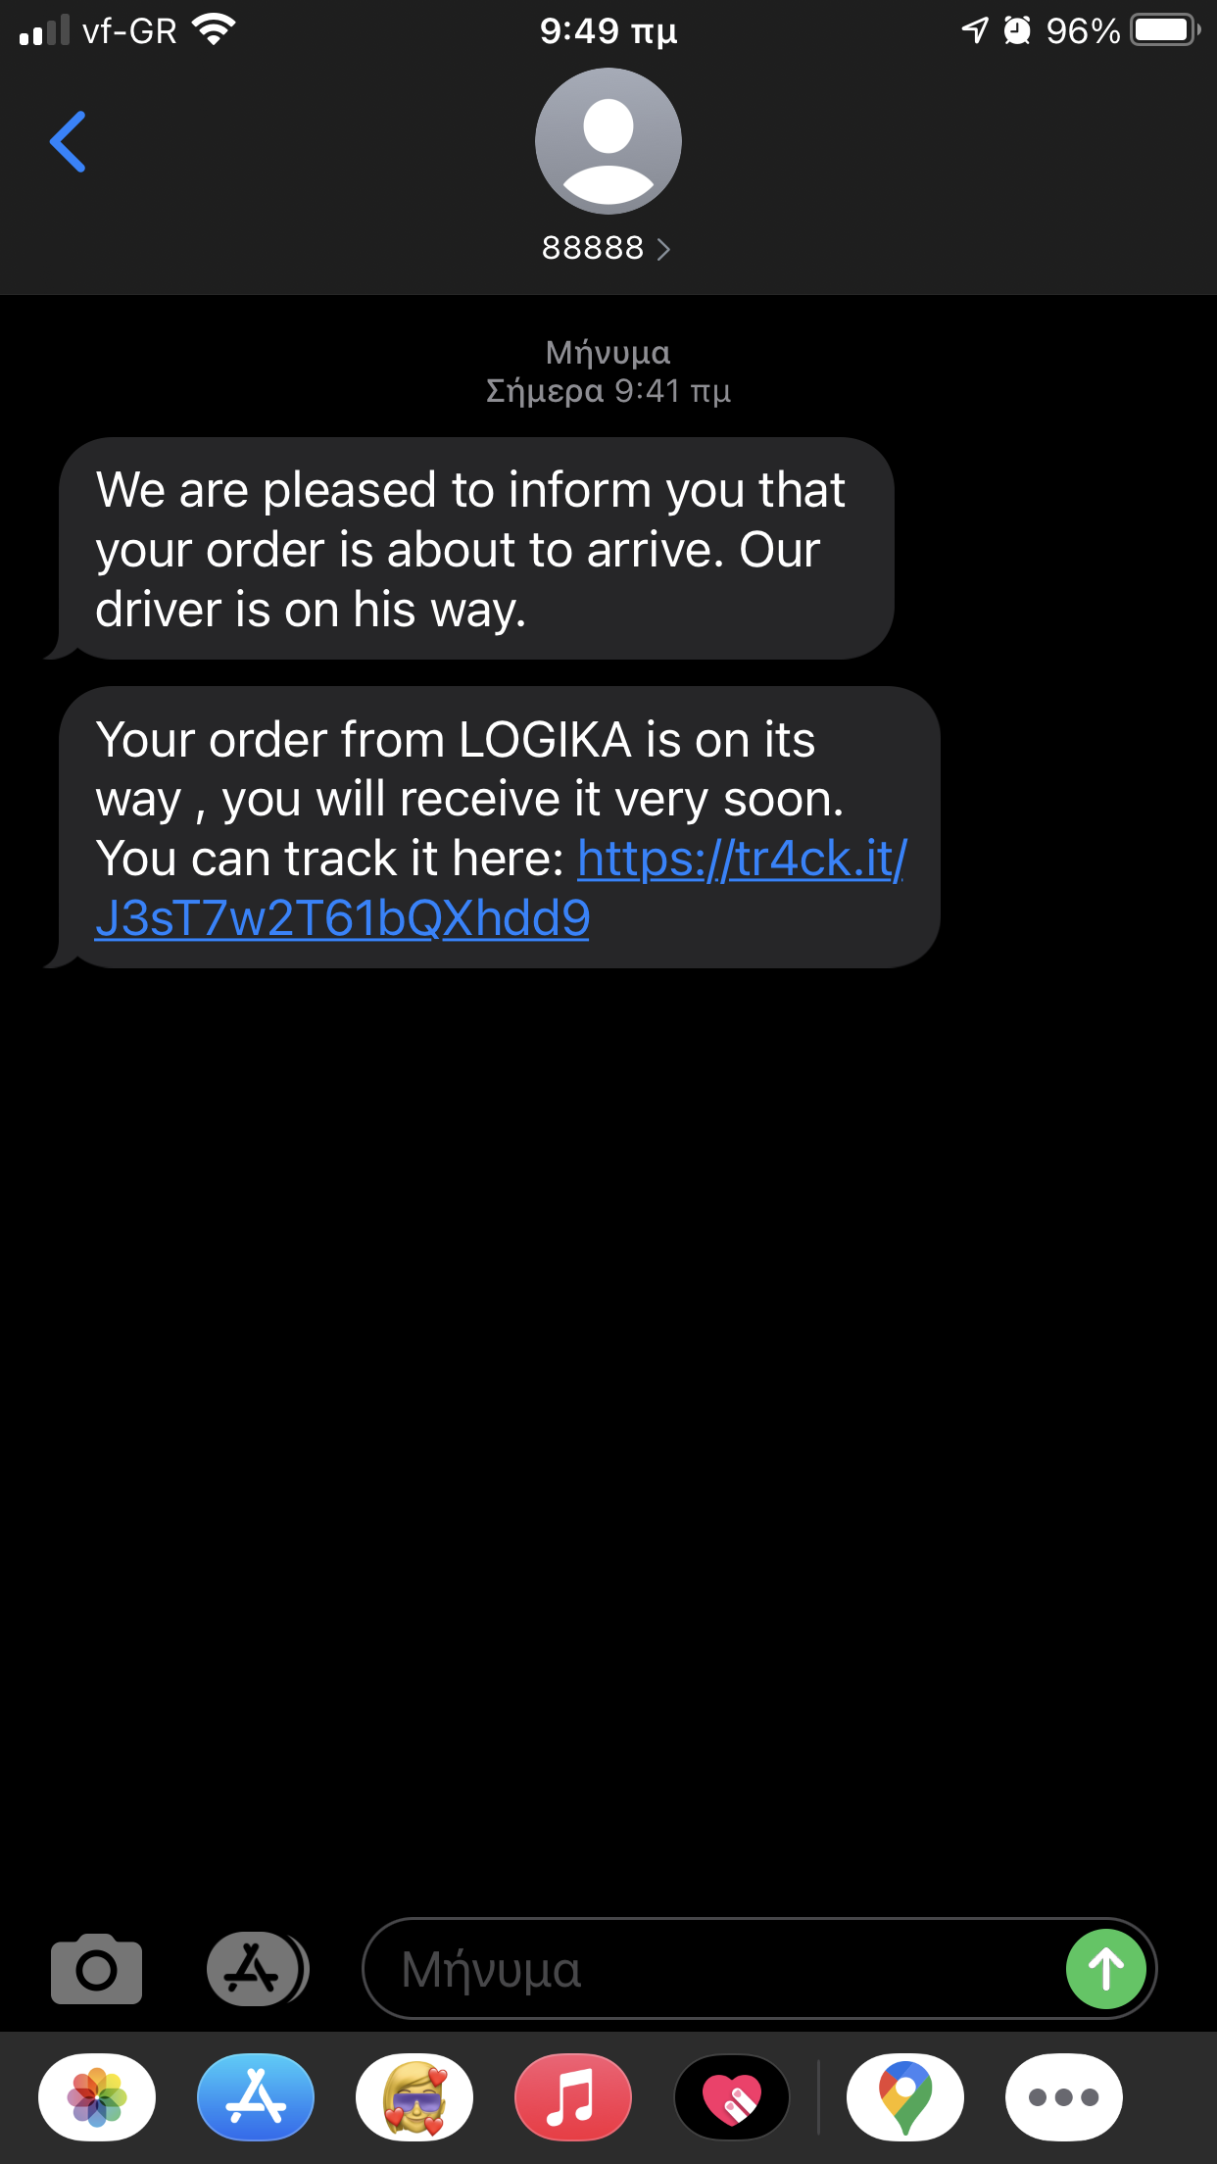
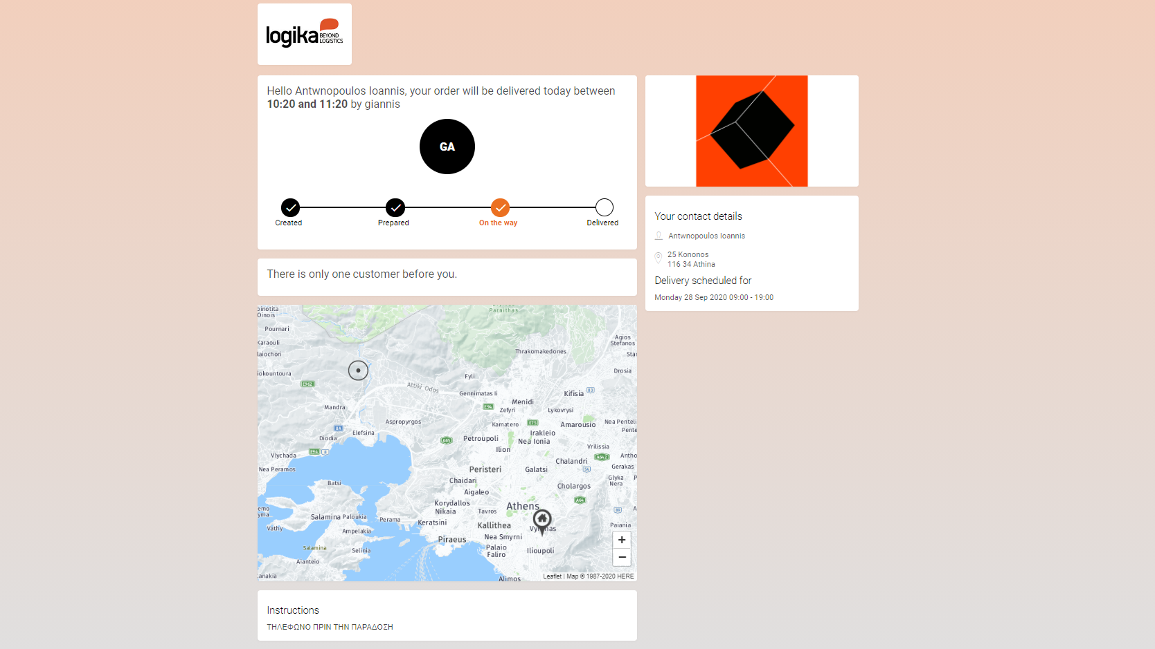
Step 3&4: SMS and web link

Slide 16
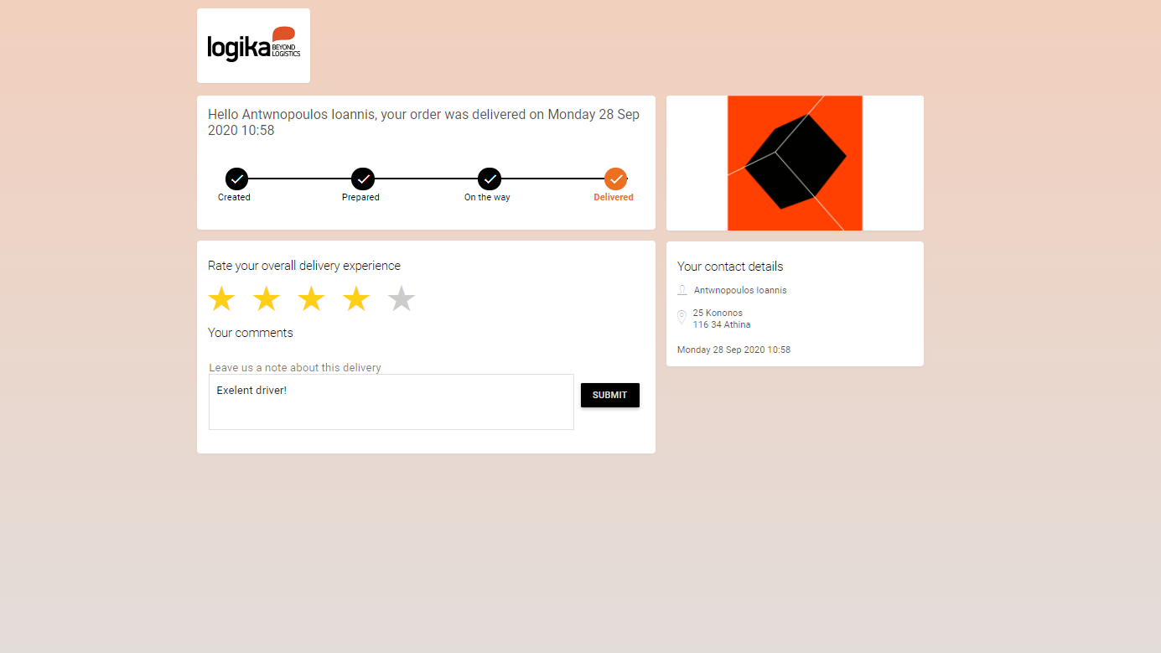
Step 5: Rating the delivery

Slide 17

1. Control Tower
A. Visibility on deliveries With live ETA
B. IOD, POD , history of orders and deliveries
C. Reverse logistics
Retailer
2. Customized BI analytics
Analytics and insights
3. Special/custom deliveries
Customized app for special deliveries

Slide 18
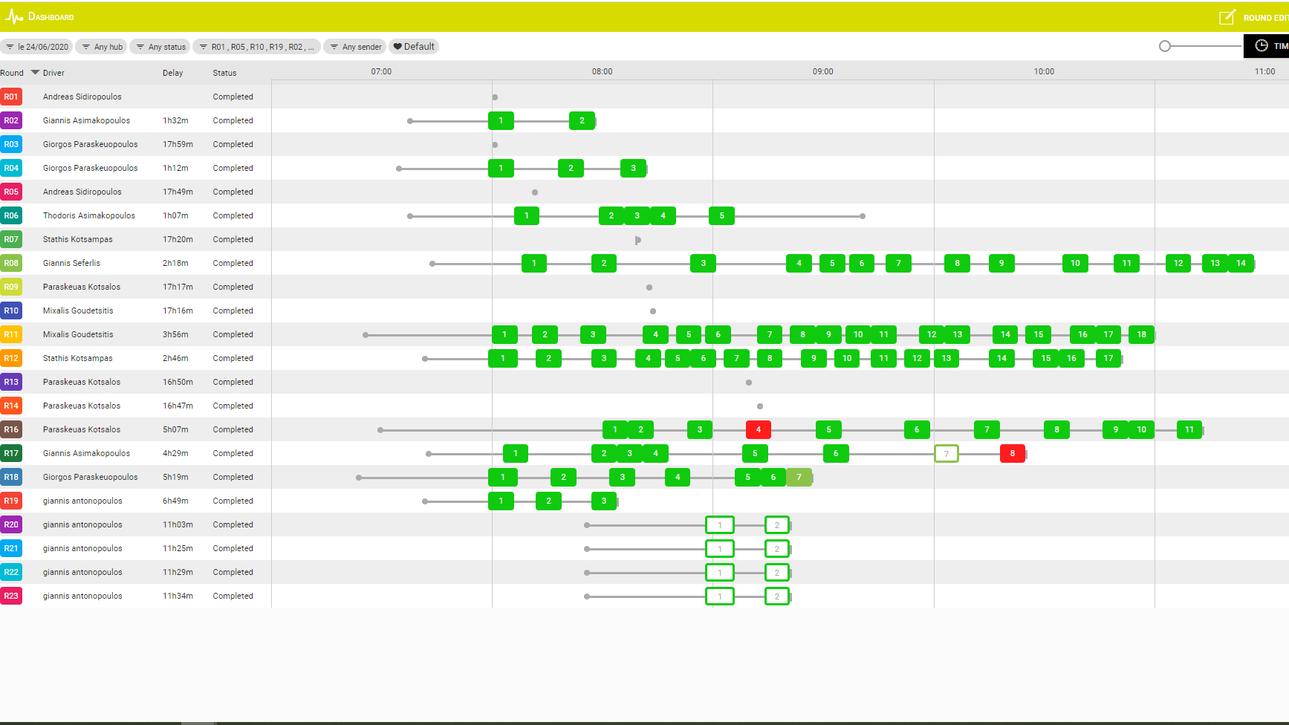
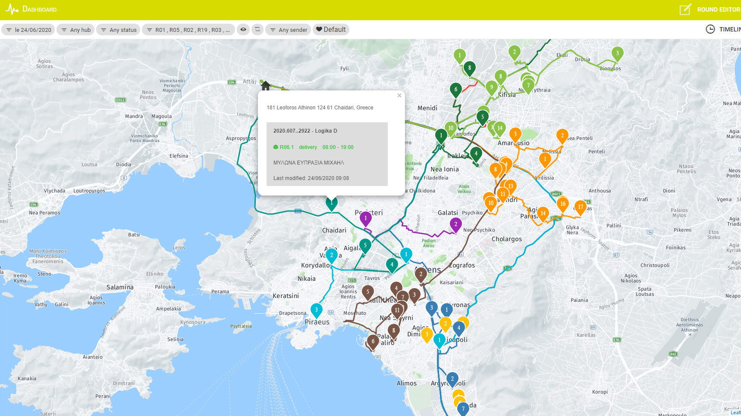
1.Retailer’s Control tower

Slide 19
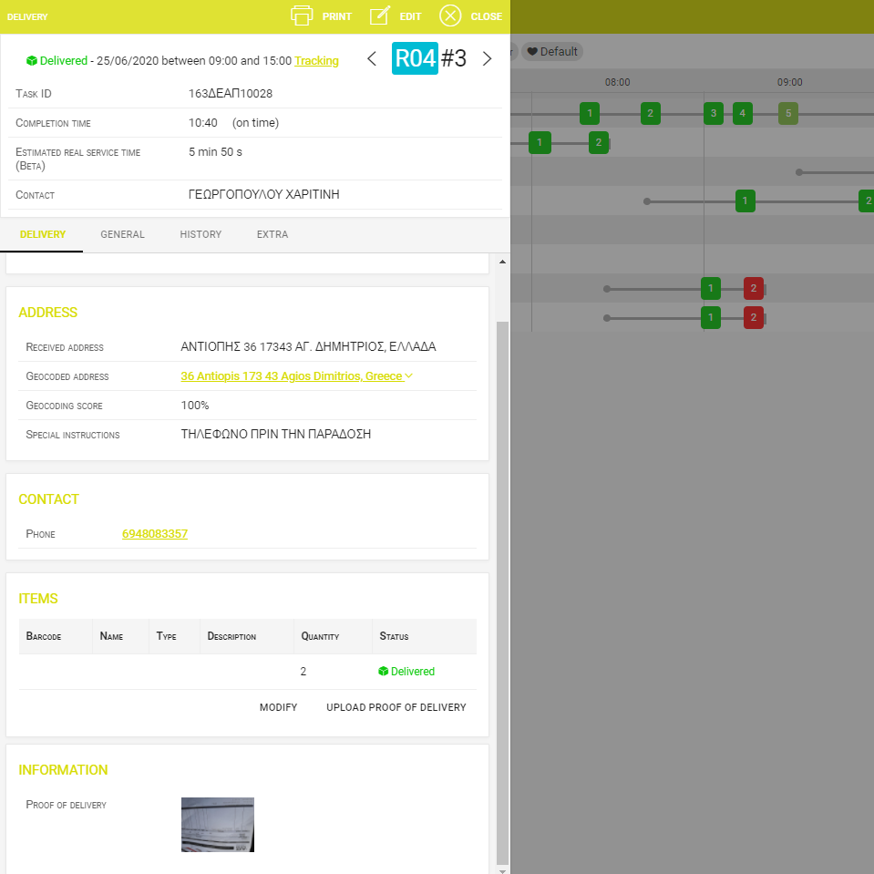
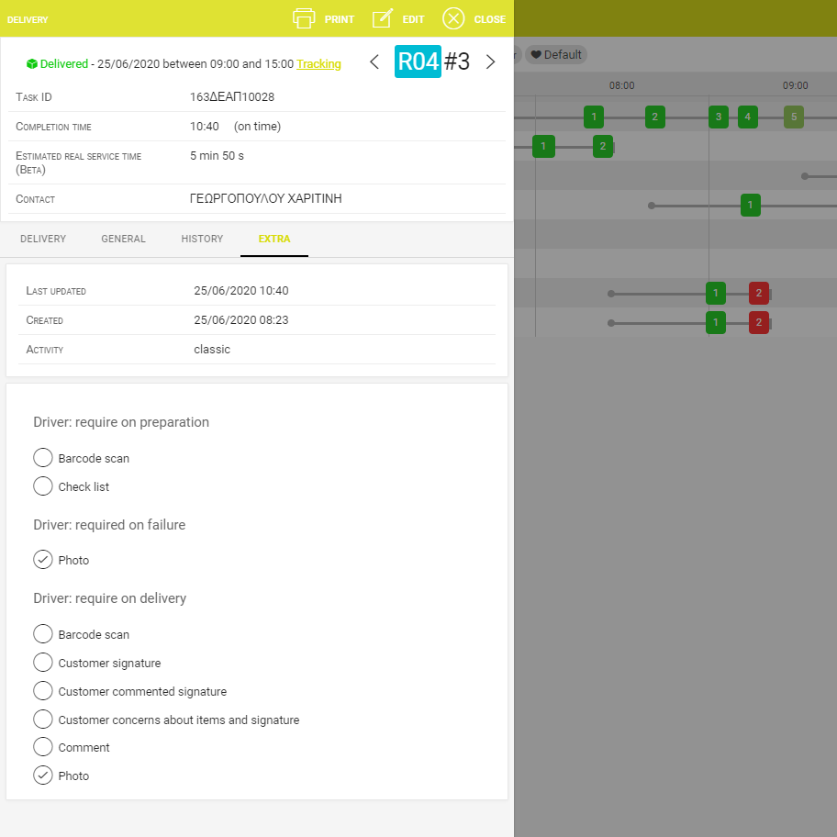
1.Control Tower
Successful delivery /Real ETA, History

Slide 20
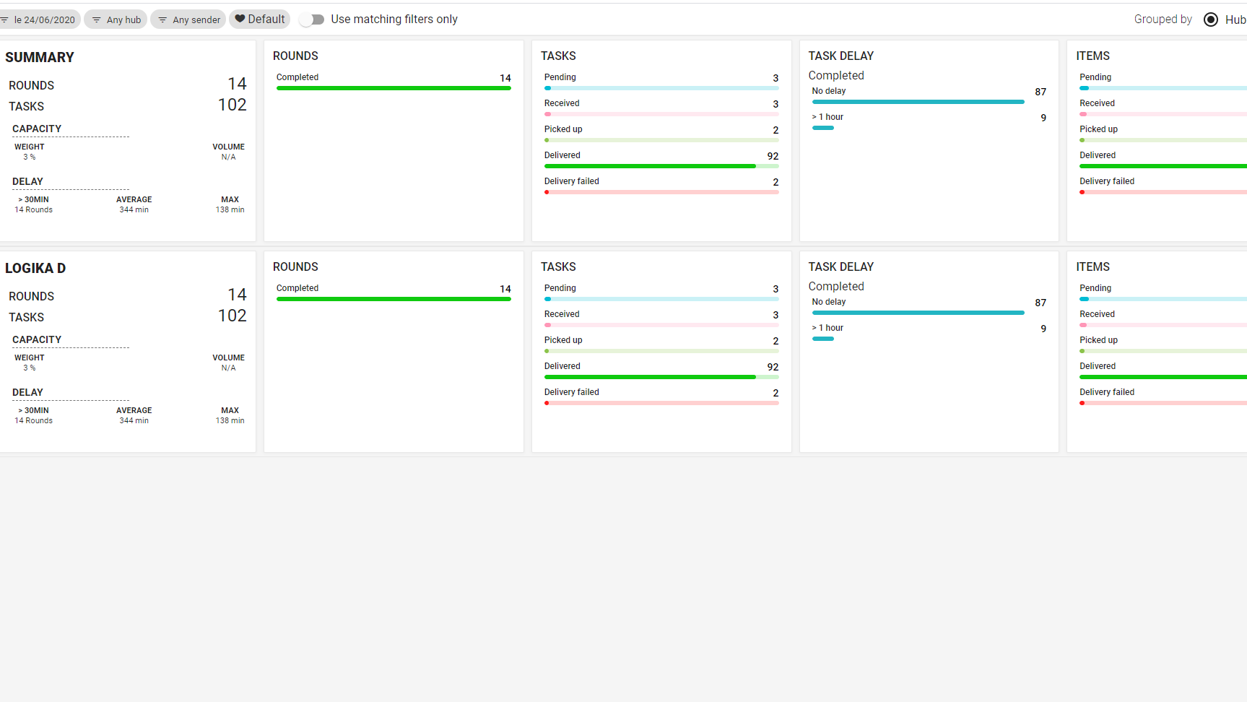
2.Analytics and Insights

Slide 21
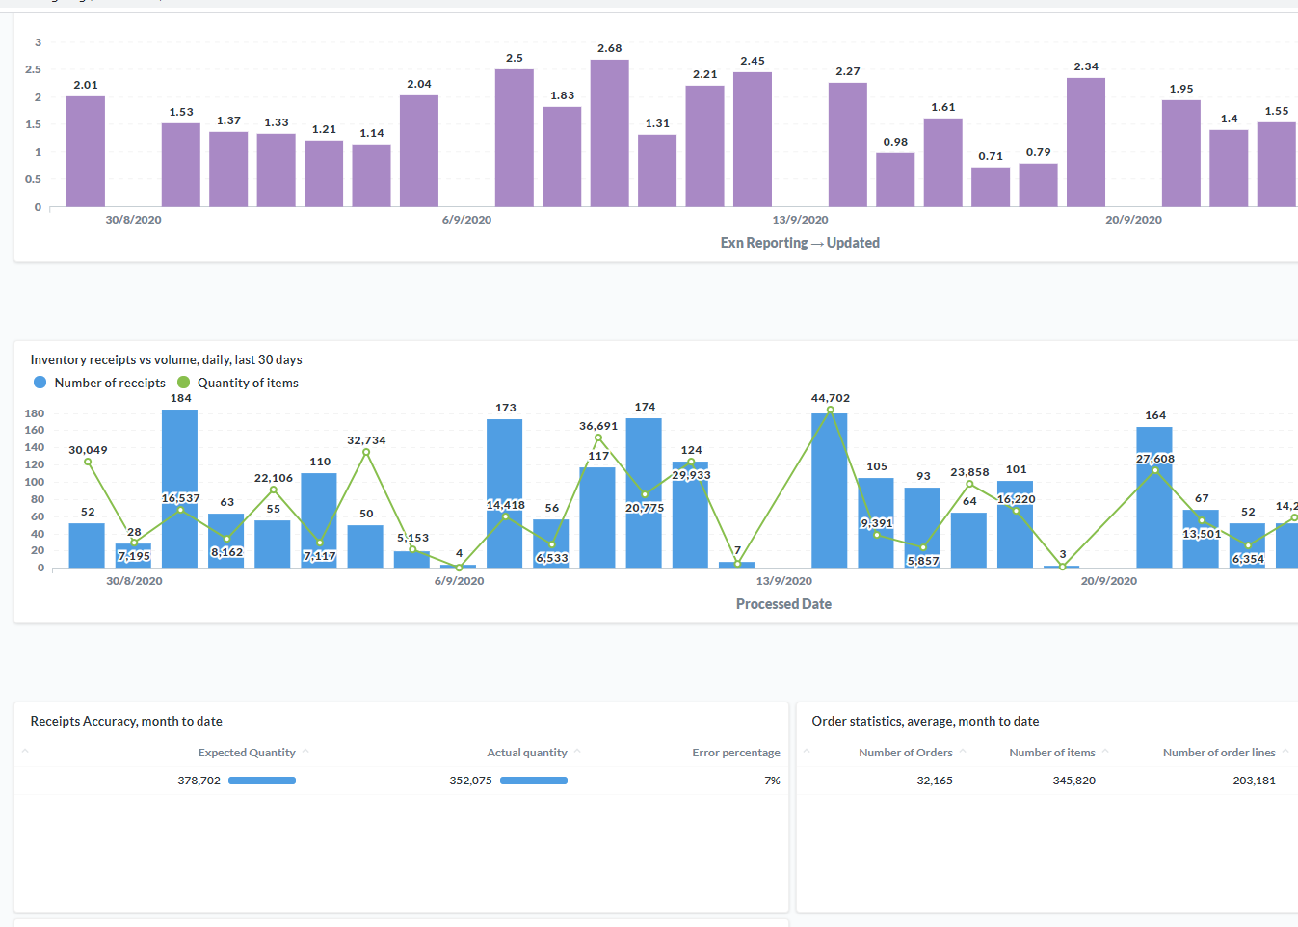
2.Customized BI analytics

Slide 22
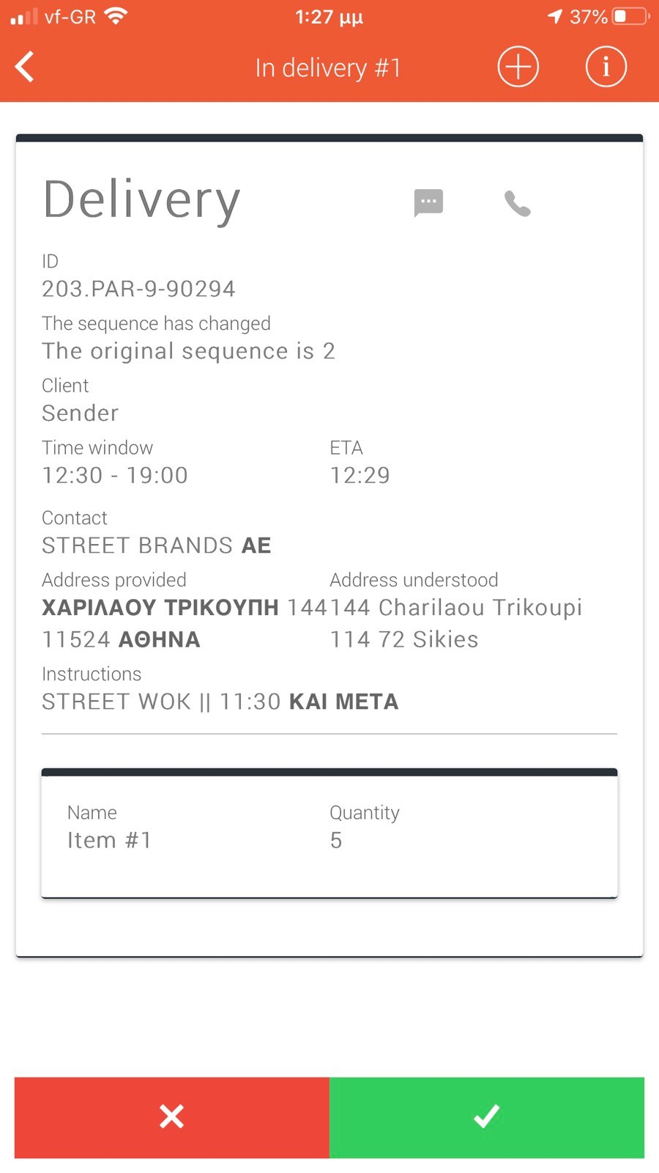
Technician App
Custom Deliveries & added value services
Click and collect
Added value services
First & last mile
Order online and
collect from store
Technician App

Slide 23
TAKE AWAYS
Retailer
End customer
End to end visibility
Real time visibility
Less administration cost
Picking a Delivery window
Live POD
Reschedule to another
date/timeslot as per customer needs’
Analytics
Unique experience
Reliable customer service info

